Slide 1
Prolog
Sec 11
Trees 2

Slide 2
Agenda
1- Delete leaf.
2- Delete node from dictionary.
3- Add root to dictionary.
4- Add node to all positions.
5- Quiz.

Slide 3
Delete Leaf
If the element I want to delete is a leaf (at the last level), then the deletation of a leaf can be in fact defined as the inverse operation of adding leaf at the last level.
delleaf(T, X, Result):-
addleaf(Result, X, T), !.

Slide 4
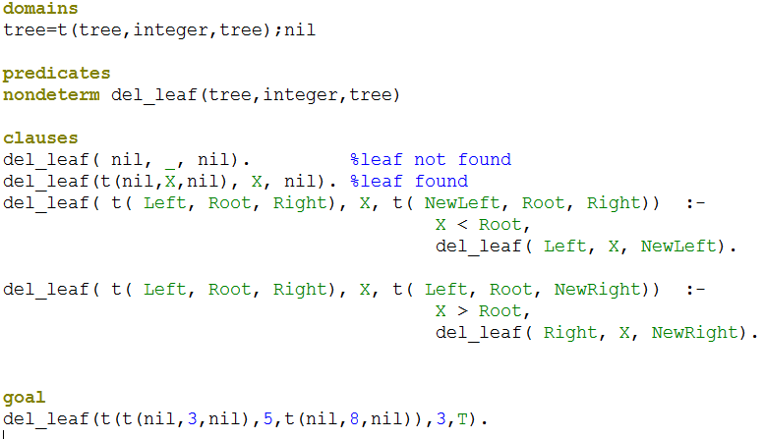
Delete Leaf (without using add_leaf)

Slide 5
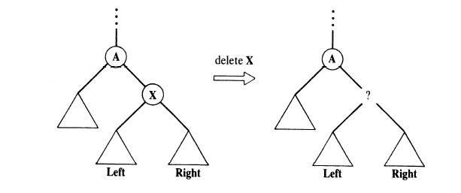
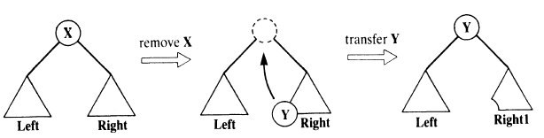
2- Delete node (not last leaf)

Slide 6
Delete node cont…
domains
tree=t(tree,integer,tree);nil
predicates
nondeterm del(tree,integer,tree)
nondeterm delmin(tree,integer,tree)
clauses
del( t( nil, X, Right), X, Right):-!.
del( t( Left, X, nil), X, Left):-!.
del( t( Left, X, Right), X, t( Left, Y, Right1)) :-%find the element in the root
delmin( Right, Y, Right1).
del( t( Left, Root, Right), X, t( Left1, Root, Right)) :-
Root > X, del( Left, X, Left1). %X < Root then find it in left
del( t( Left, Root, Right), X, t( Left, Root, Right1)) :-
X > Root, del( Right, X, Right1). % X > Root then change in right
Given sub tree
Min element in given subtree
Subtree without the min element

Slide 7

Delete node cont…
delmin( t( nil, Y, R), Y, R). %left node is empty then root ’Y’ has the min value.
delmin( t( Left, Root, Right), Y, t( Left1, Root, Right)) :-
delmin( Left, Y, Left1).
goal
del(t(t(nil,3,nil),5,t(nil,8,nil)),5,T).

Slide 8
Delete node (Example)
Delete 5
del( t( nil, X, Right), X, Right):-!.
del( t( Left, X, nil), X, Left):-!.
del( t( Left, X, Right), X, t( Left, Y, Right1)) :-
delmin( Right, Y, Right1).
del( t( Left, Root, Right), X, t( Left1, Root, Right)) :-
Root > X, del( Left, X, Left1).
del( t( Left, Root, Right), X, t( Left, Root, Right1)) :-
X > Root, del( Right, X, Right1).
delmin( t( nil, Y, R), Y, R).
delmin( t( Left, Root, Right), Y, t( Left1, Root, Right)) :-
delmin( Left, Y, Left1).
5
3
8
2
4
6
9
The Result
6
7
3
8
Right1
Y=6, R=t(nil,7,nil)
8
2
4
7
9
7
9
Left1=t(nil,7,nil)

Slide 9
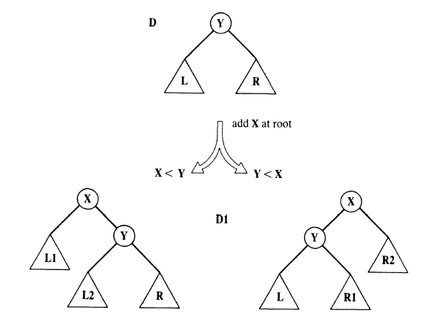
Add root
If x < Y,
-Then Y will be at right of root X and all what was greater than Y will still be at their same place right to Y
What was smaller than Y will be divided
either smaller than Y but greater than X; than add it to left of Y (L2)
Or smaller than Y and smaller than X; then add it to left of X (L1)
Notes:
If x < Y,
-Then Y will be at right of root X and all what was greater than Y will still be at their same place right to Y
What was smaller than Y will be divided
either smaller than Y but greater than X; than add it to left of Y
Or smaller than Y and smaller than X; then add it to left of X

Slide 10

Add root
domains
tree=t(tree,integer,tree);nil
predicates
nondeterm addroot(tree,integer,tree)
gt(integer,integer)
clauses
addroot( nil, X, t( nil, X, nil)).
addroot( t( L, Y, R), X, t( L1, X, t( L2, Y, R))) :-
gt( Y, X), addroot( L, X, t( L1, X, L2)).
addroot( t( L, Y, R), X, t( t( L, Y, R1), X, R2)) :-
gt( X, Y), addroot( R, X, t( R1, X, R2)).
gt(X,Y):- X > Y.
goal
addroot(t(t(nil,1,nil),5,t(nil,8,nil)),2,T).

Slide 11
Add root (Example)
Add 2
5
addroot( nil, X, t( nil, X, nil)).
addroot( t( L, Y, R), X, t( L1, X, t( L2, Y, R))) :-
gt( Y, X), addroot( L, X, t( L1, X, L2)).
addroot( t( L, Y, R), X, t( t( L, Y, R1), X, R2)) :-
gt( X, Y), addroot( R, X, t( R1, X, R2)).
3
8
1
4
6
9
L=nil
2
R=nil
R1=nil, R2=nil
Add 2
3
1
5
2
1
4
3
8
1
3
2
4
6
9
4
Add 2
1
1

Slide 12
Add node to all positions
5
Add 2 to this tree
3
8
2
5
5
5
2
8
3
8
3
8
3
2
Level 2
(Add 2 as root for each possible subtree )
Level 1
(addRoot)
Level 3
(addLeaf)

Slide 13
Add node to all positions
domains
tree=t(tree,integer,tree);nil
predicates
nondeterm add(tree,integer,tree)
nondeterm addroot(tree,integer,tree)
gt(integer,integer)
clauses
add( Tree, X, NewTree) :-
addroot( Tree, X, NewTree).
add( t( L, Y, R), X, t( L1, Y, R)) :-
gt( Y, X), add( L, X, L1).
add( t( L, Y, R), X, t( L, Y, R1)) :-
gt( X, Y), add( R, X, R1).

Slide 14
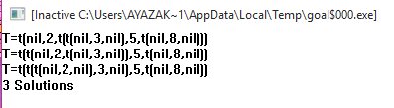
Add node to all positions cont…
addroot( nil, X, t( nil, X, nil)).
addroot( t( L, Y, R), X, t( L1, X, t( L2, Y, R))) :-
gt( Y, X),
addroot( L, X, t( L1, X, L2)).
addroot( t( L, Y, R), X, t( t( L, Y, R1), X, R2)) :-
gt( X, Y),
addroot( R, X, t( R1, X, R2)).
gt(X,Y):- X > Y.
goal
add(t(t(nil,3,nil),5,t(nil,8,nil)),2,T).

Slide 15
Quiz 15 Minutes

